Slide 1

Web Application Development
Entity Framework and DB connections (CRUD)
By Ebad Majeed

Slide 2
Prerequisites (Code first approach)
Visual Studio 2022
Framework: Dot Net 8.0
SQL Server (local instance)
Workloads
ASP.NET and web development (under Web & Cloud)
.NET Core cross-platform development (under Other Toolsets)
SQL Server support package

Slide 3
Sequence
Creating a new project
Creating Model classes
Adding DBContext model class
Registering the context with dependency injection
Adding the Database Connection string
Adding the Migrations
Adding the Controllers

Slide 4
Creating Model Classes (Examples)
Grade:
public class Grade
{
public int GradeId { get; set; }
public string GradeName { get; set; }
public string Section { get; set; }
public ICollection<Student> Students { get; set; }
}
Student:
public class Student
{
public int StudentID { get; set; }
public string StudentName { get; set; }
public DateTime? DateOfBirth { get; set; }
public decimal Height { get; set; }
public float Weight { get; set; }
public Grade Grade { get; set; }
}

Slide 5
Adding DBContext model class
public class SchoolContext: DbContext
{
public SchoolContext(DbContextOptions<SchoolContext> options)
: base(options)
{ }
public DbSet<Grade> Grades { get; set; }
public DbSet<Student> Students { get; set; }
}
Notes:
Install entityframeworkcore from nuget package manager to remove the error

Slide 6
Registering the context with Dependency Injection
In program.cs project file we add this code
builder.Services.AddDbContext<SchoolContext>(options =>
options.UseSqlServer(builder.Configuration.GetConnectionString("Connection")));
Notes:
Install sqlserver (entityframeworkcore) dependency using nuget package manager

Slide 7
Adding the Database connection string
In appsettings.json project file we add connection string to our Database Server (Please note that you would write your own credentials):
"ConnectionStrings": {
"Connection": "Server=(localdb)\MSSQLLocalDB;Database=School;Trusted_Connection=True;"
}
//(localdb)\MSSQLLocalDB is default server name, could be different depending on your source server name is + Database

Slide 8
Adding the Migrations
Go to Tools > NuGet package manager > Package manager console and type these two commands
Add-Migration InitialCreate
This command will create a class named InitialCreate in which code to create tables for your models will be present
Update-Database
This will create a database based on information from InitialCreate class
Notes:
Install tools (entityframeworkcore) dependency using nuget package manager

Slide 9
Adding the Controllers
Right click on the Controller folder in your project and add Controller:
Select MVC Controller with views, using Entity Framework
This will not only generate the controller code for you but will add the .cshtml views as well with the help of Scaffolding.

Slide 10
Prerequisites (DB first approach)
Visual Studio 2022
Framework: Dot Net 8.0
SQL Server (local instance)
Workloads
ASP.NET and web development (under Web & Cloud)
.NET Core cross-platform development (under Other Toolsets)
SQL Server support package

Slide 11
Sequence (Backend)
Creating a new Database
Create New Project
Adding the Database Connection string
Create Model based on Database
Will add DBContext model class
Registering the context with dependency injection
Adding the Controllers

Slide 12
Creating Database Tables (Many to many)
Student
ID
FirstName
LastName
EnrollmentDate
Course
CourseID
Title
Credits
Notes:
Many to many relationship

Slide 13
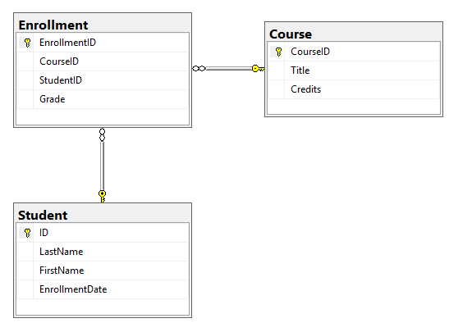
Breaking the many to many relationship
Enrollment
EnrollmentID
CourseID
StudentID
Grade

Slide 14
Creating a new Project
Open Visual Studio and File -> New -> Project
Select MVC model inside a Core Website template.

Slide 15
DB Script to generate tables (Students)
-- Create the Students table
CREATE TABLE Students
(
StudentID INT PRIMARY KEY IDENTITY,
StudentName VARCHAR(100)
);

Slide 16
DB Script to generate tables (Courses)
-- Create the Courses table
CREATE TABLE Courses
(
CourseID INT PRIMARY KEY IDENTITY,
CourseName VARCHAR(100)
);

Slide 17
DB Script to generate tables (Enrollments)
-- Create the Enrollments table
CREATE TABLE Enrollments
(
EnrollmentID INT PRIMARY KEY IDENTITY,
StudentID INT,
CourseID INT,
FOREIGN KEY (StudentID) REFERENCES Students(StudentID),
FOREIGN KEY (CourseID) REFERENCES Courses(CourseID),
Grade VARCHAR(2)
);

Slide 18
Adding the Database connection string
In appsettings.json project file we add connection string to our Database Server (Please note that you would write your own credentials):
"ConnectionStrings": {
"Connection": "Server=(localdb)\MSSQLLocalDB;Database=School;Trusted_Connection=True;"
}
//(localdb)\MSSQLLocalDB is default server name, could be different depending on your source server name is + Database

Slide 19
Create Model based on Database
Tools –> NuGet Package Manager –> Package Manager Console
Run the following command to create a model from the existing database:
Scaffold-DbContext -Connection name=Connection -Provider Microsoft.EntityFrameworkCore.SqlServer -OutputDir Models
Notes:
Microsoft.EntityFrameworkCore.Tools
Microsoft.EntityFrameworkCore.SqlServer

Slide 20
Registering the context with Dependency Injection
In program.cs project file we add this code
builder.Services.AddDbContext<SchoolContext>(options =>
options.UseSqlServer(builder.Configuration.GetConnectionString("Connection")));

Slide 21
Adding the Controllers
Right click on the Controller folder in your project and add Controller:
Select API Controller, using Entity Framework

